Slide 1
Japanese Restaurant in Toronto
Lorenzo Stocchi
January 25, 2021

Slide 2
Table of Contents
Introduction
Target Audience
Data Overview
Methodology
Discussion
Conclusion

Slide 3
1 - Introduction (Identifying the Business Problem)
Toronto is one of the most densely populated areas in Canada.
Multiculturalism is seen through the various neighbourhoods including; Chinatown, Corso Italia, Little India, Kensington Market, Little Italy, Koreatown and many more.
Being the land of opportunity, it brings in a variety of people from different ethnic backgrounds to the core city of Canada, Toronto. Being the largest city in Canada with an estimated population of over 6 million, there is no doubt about the diversity of the population.
Downtown Toronto being the hub of interactions between ethnicities brings many opportunities for entrepreneurs to start or grow their business.
The objective of this project is to use Foursquare location data and regional clustering of venue information to determine what might be the ‘best’ neighbourhood in Toronto to open a Japanese Restaurant.
It is a place where people can try the best of each culture, either while they work or just passing through. Toronto is well known for its great food.
Toronto has a population of Japanese Canadians and also one of Japanese nationals. As of 2010 there are about 20,000 Japanese Canadians in Toronto. Adam McDowell of the National Post stated that Toronto's Japanese community was "never very large compared to, say, the Chinese or Italian communities".
Despite there being a lot of Japanese themed restaurants. Through this project, we will find the most suitable location for an entrepreneur to open a new Japanese restaurant in Toronto, Canada.

Slide 4
2 - Target Audience
This project is aimed towards Entrepreneurs or Business owners who want to open a new Japanese Restaurant or grow their current business. The analysis will provide vital information that can be used by the target audience.

Slide 5
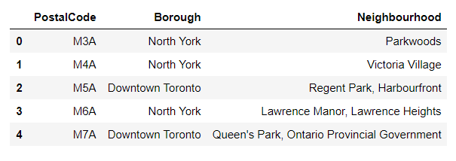
3 - Data Overview
The data that will be required will be a combination of CSV files that have been prepared for the purposes of the analysis from multiple sources which will provide the list of neighbourhoods in Toronto (via Wikipedia), the Geographical location of the neighbourhoods (via Geocoder package) and Venue data pertaining to Japanese Restaurants (via Foursquare). The Venue data will help find which neighbourhood is best suitable to open a Japanese Restaurant.
2.1 — Data acquisition:
Source 1: Toronto Neighborhoods via Wikipedia

Slide 6
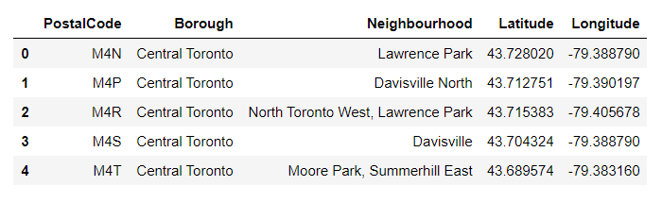
3 - Data Overview
Source 2: Geographical Location data using Geocoder Package
The second source of data provided us with the Geographical coordinates of the neighbourhoods with the respective Postal Codes. The file was in CSV format, so we had to attach it to a Pandas data frame.

Slide 7
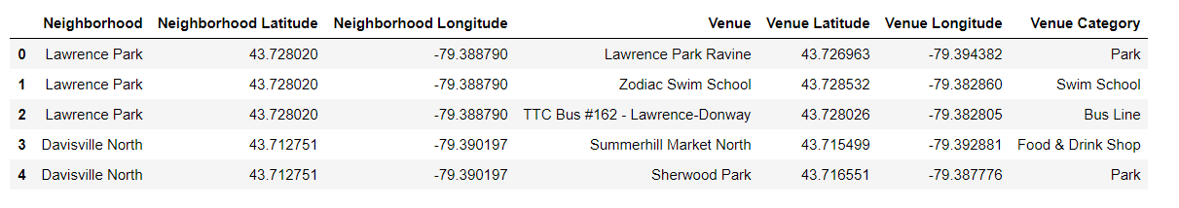
3 - Data Overview
Source 3: Venue Data using Foursquare
We performed a bit of data cleansing. Then the neighbourhoods are grouped by the name of the neighbourhood, so data clustering is made easier later on.

Slide 8
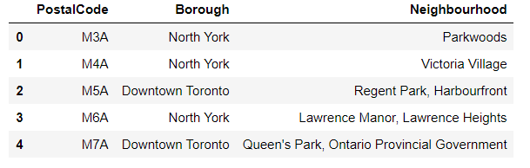
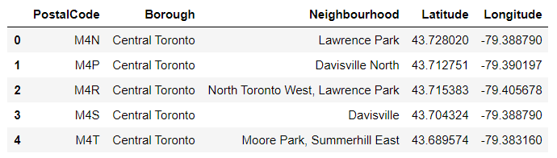
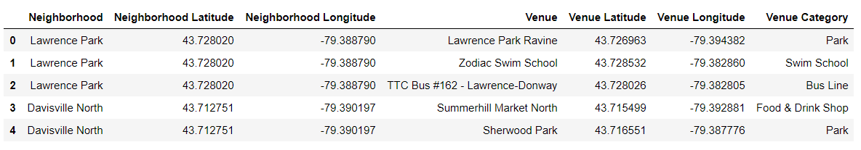
4 - Methodology
4.1 — Data Cleansing

Slide 9
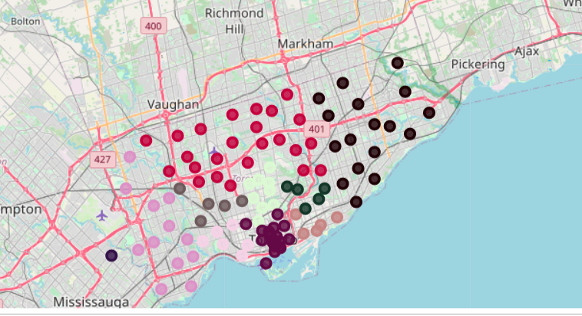
4 - Methodology
4.2 — Data Exploration

Slide 10
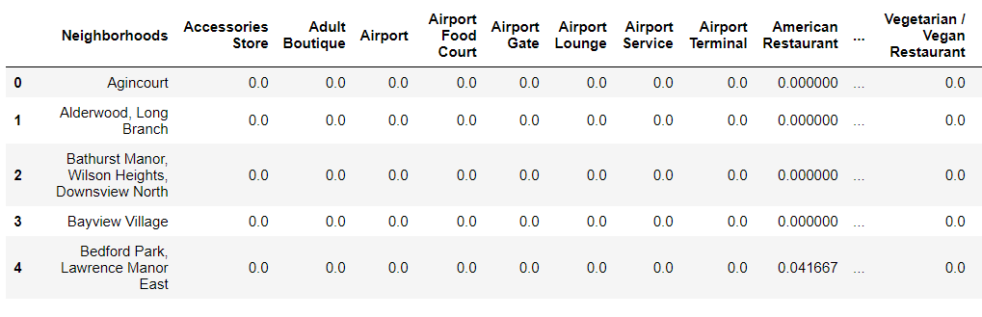
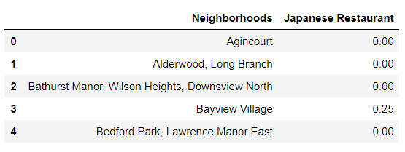
4 - Methodology
4.3 — Machine Learning

Slide 11
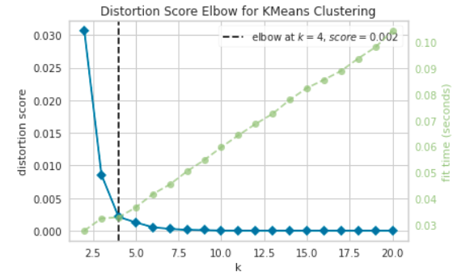
4 - Methodology
4.3 — Machine Learning
K-Means Clustering

Slide 12
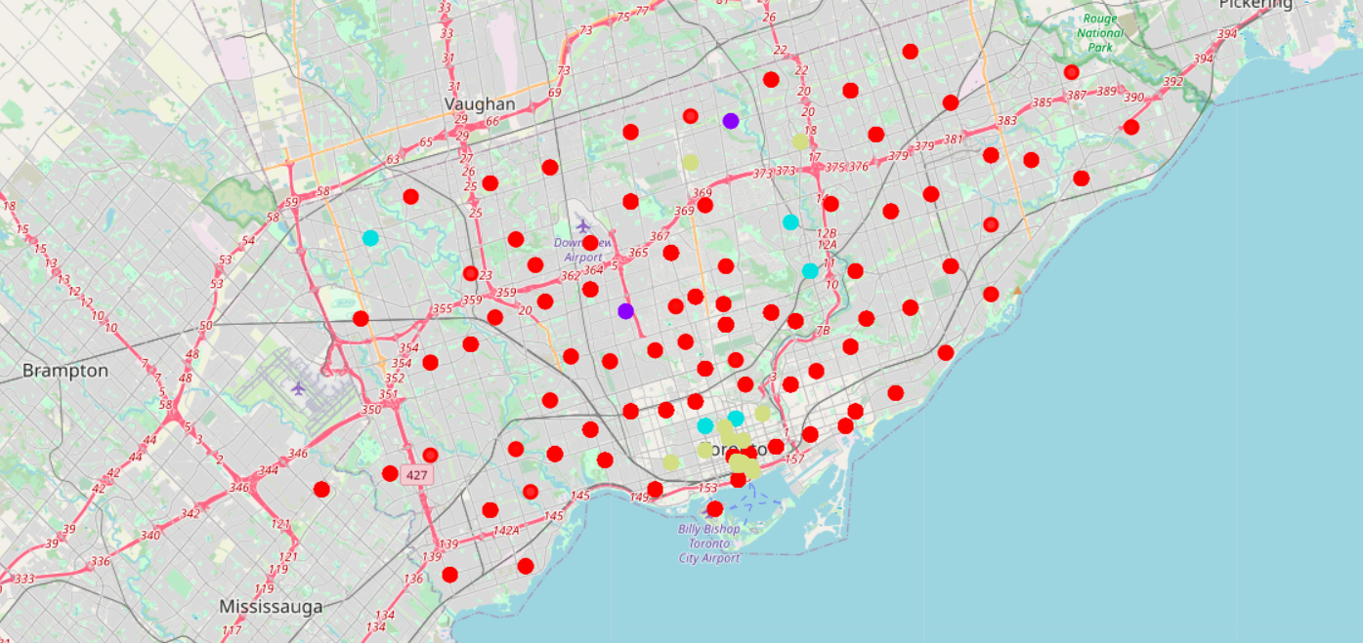
4 - Methodology
4.3 — Machine Learning
K-Means Clustering

Slide 13
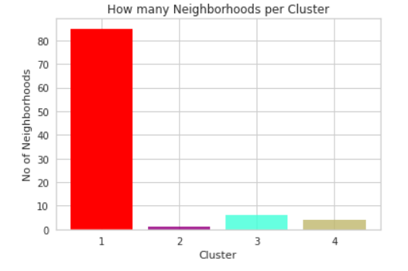
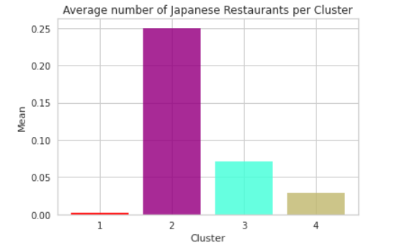
4 - Methodology
4.4 - Data Analysis

Slide 14
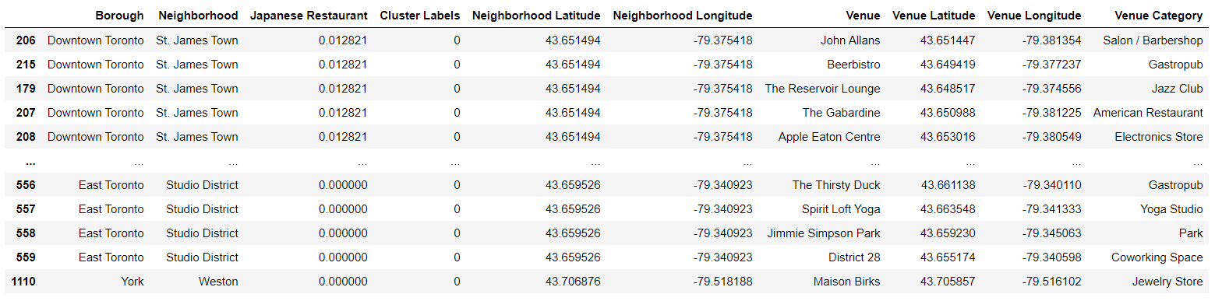
4 - Methodology
4.4 - Data Analysis
Cluster Analysis –Cluster 1

Slide 15
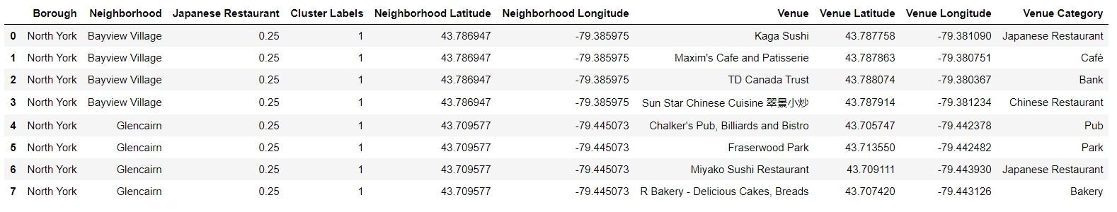
4 - Methodology
4.4 - Data Analysis
Cluster Analysis –Cluster 2

Slide 16
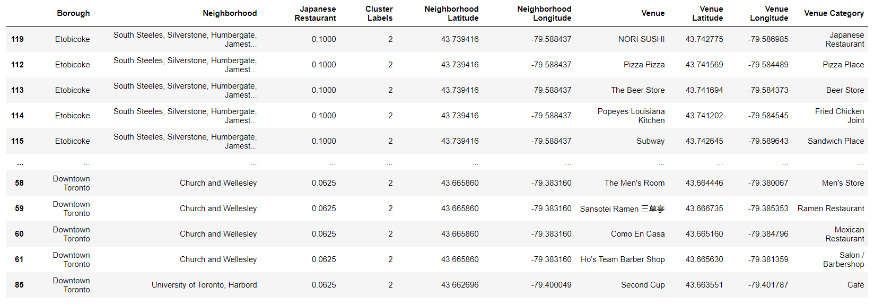
4 - Methodology
4.4 - Data Analysis
Cluster Analysis –Cluster 3

Slide 17
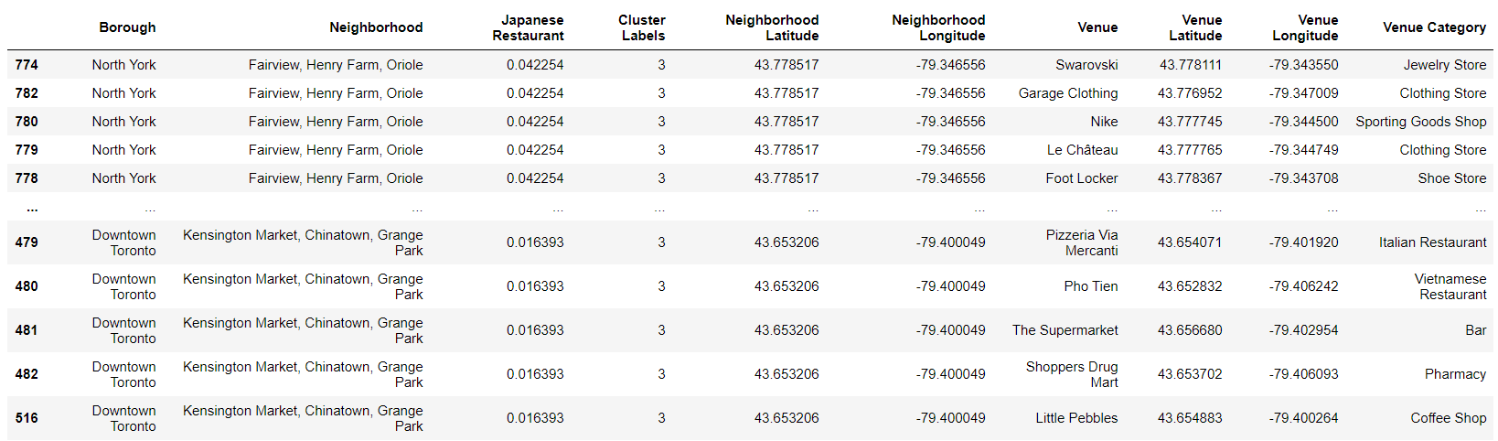
4 - Methodology
4.4 - Data Analysis
Cluster Analysis –Cluster 4

Slide 18
5 - Discussion
Most of the Japanese Restaurants are in cluster 4 represented by the Dark Khaki cluster.
The Neighborhoods located in the North York area that have the highest average of Japanese Restaurants are Bayview Village and Glencairn.
Even though there is a huge number of Neighborhoods in cluster 1, there is little to no Japanese Restaurant.
We see that in the Downtown Toronto area (cluster 4) has the second last average of Japanese Restaurants. Looking at the nearby venues, the optimum place to put a new Japanese Restaurant in Downtown Toronto as there are many Neighborhoods in the area but little to no Japanese Restaurants, therefore, eliminating any competition.
The second-best Neighborhoods that have a great opportunity would be in areas in Cluster 1. Having 77 neighbourhoods in the area with no Japanese Restaurants gives a good opportunity for opening a new restaurant. Some of the drawbacks of this analysis are — the clustering is completely based on data obtained from the Foursquare API. Also, the analysis does not take into consideration of the Japanese population across neighbourhoods as this can play a huge factor while choosing which place to open a new Japanese restaurant. This concludes the optimal findings for this project and recommends the entrepreneur to open an authentic Japanese restaurant in these locations with little to no competition.

Slide 19
6 - Conclusion
In conclusion, to end off this project, we had an opportunity on a business problem, and it was tackled in a way that it was similar to how a genuine data scientist would do. We utilized numerous Python libraries to fetch the information, control the content and break down and visualize those datasets. We have utilized Foursquare API to investigate the settings in neighbourhoods of Toronto, get a great measure of data from Wikipedia which we scraped with the Beautifulsoup Web scraping Library. We also visualized utilizing different plots present in seaborn and Matplotlib libraries. Similarly, we applied AI strategy to anticipate the error given the information and utilized Folium to picture it on a map.
Places that have room for improvement or certain drawbacks give us that this project can be additionally improved with the assistance of more information and distinctive Machine Learning strategies. Additionally, we can utilize this venture to investigate any situation, for example, opening an alternate cuisine or opening of a Movie Theater and so forth. Ideally, this task acts as an initial direction to tackle more complex real-life problems using data science.

